Slide 1

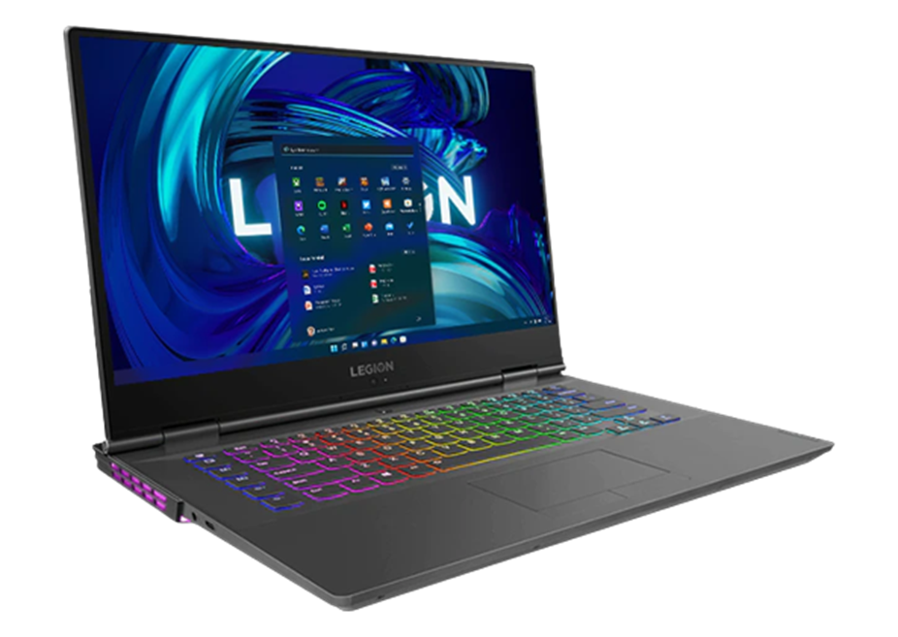
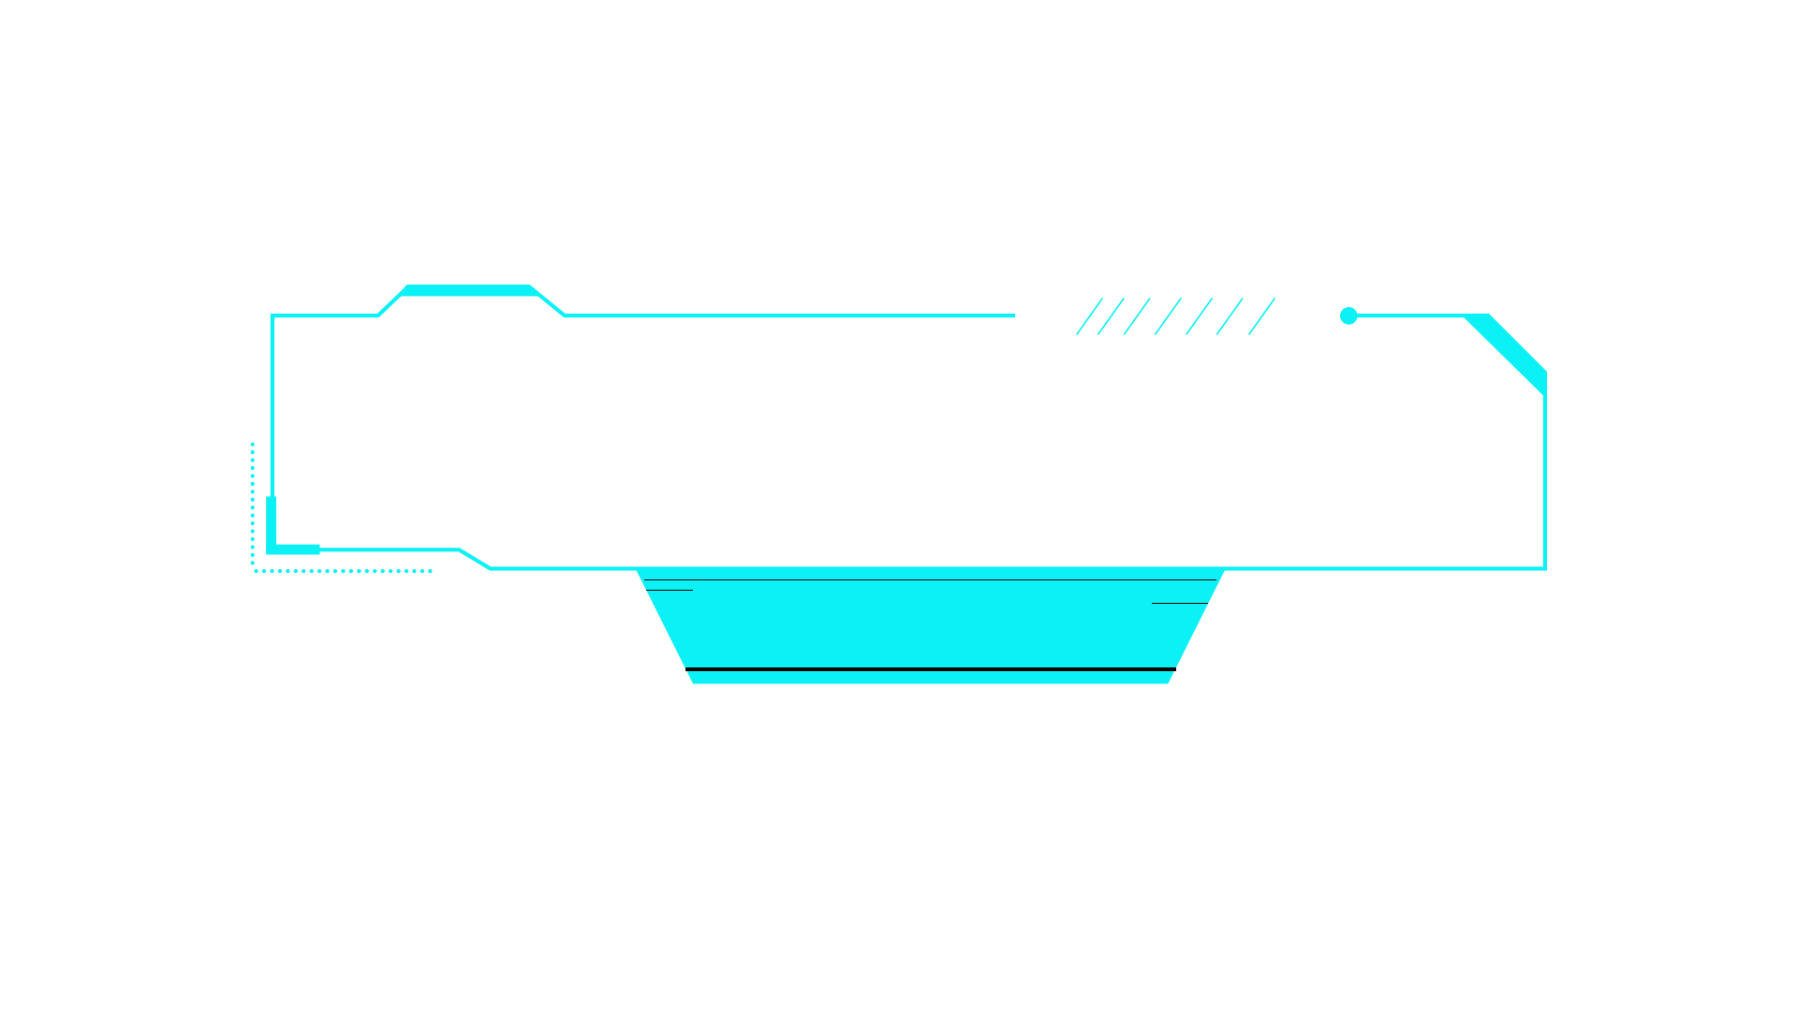
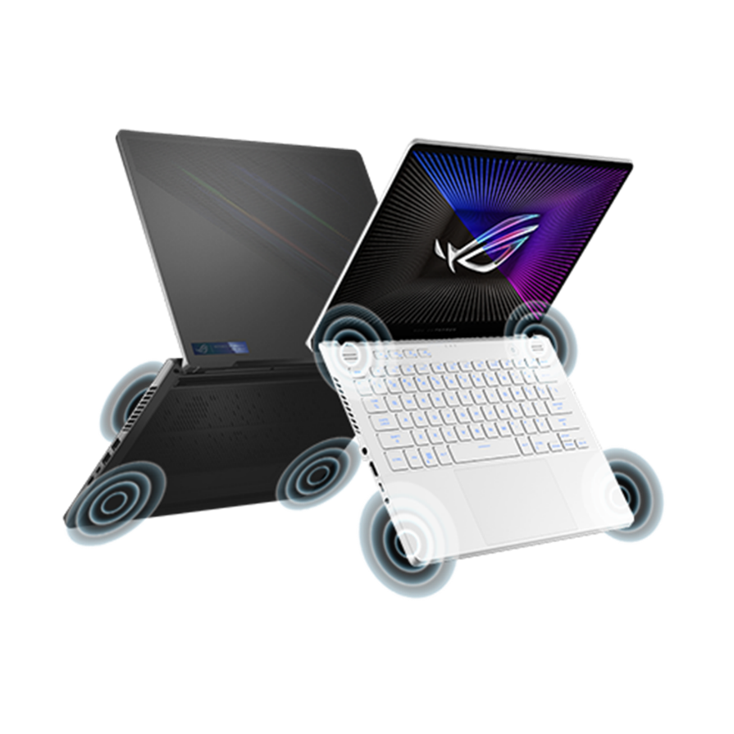
Comparation
Lenovo
VS
ROG ASUS
Let’s Go

Slide 2
MEMBERS
FAWWAZ ALIFIO FARSA
(2341720128)
GHOFFAR ABDUL JA’FAR
(2341720035)

Slide 3
01
About

Slide 4
1
Lenovo Legion Y740
PRICE
Lenovo Legion Y740 prices start from IDR 20,499,000
ROG Zephyrus G14
With high performance from Intel® and NVIDIA® wrapped in a thin and light aluminum chassis, the Lenovo Legion Y740 15.6” laptop is a gaming masterpiece. Featuring best-in-class system lighting from Corsair® iCUE and immersive visuals and immersive audio from Dolby®, the Legion Y740 is designed to deliver a near-perfect gaming experience.

Slide 5
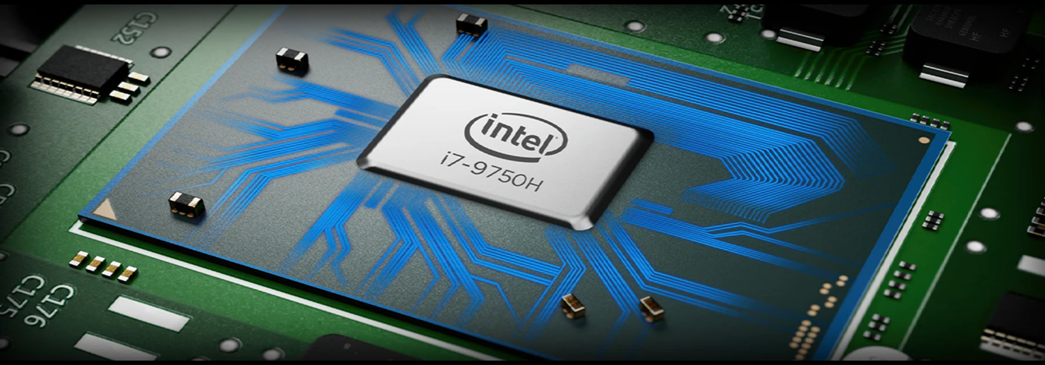
Lenovo Legion Y740
Processor
9th Generation Intel® Core™ processors deliver desktop-caliber gaming that you can take anywhere. With up to 4.5GHz Turbo, 6 cores, and 12 threads, the Legion laptop equipped with this processor has enough power to handle tough AAA games.

Slide 6
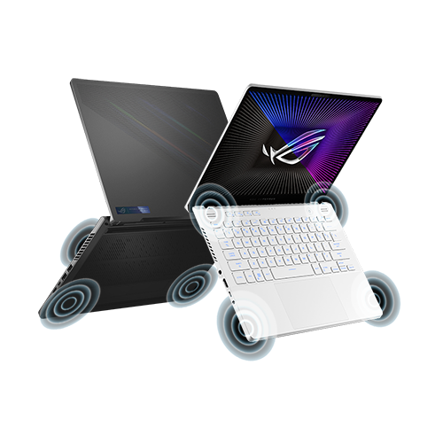
1
ROG Zephyrus G14
PRICE
ASUS ROG Zephyrus G14 prices start from IDR 23,999,000
ROG Zephyrus G14
ROG Zephyrus G14 can be called a powerful gaming laptop. The beautiful design according to the ROG edition has a cooling system that is good for gaming laptops

Slide 7
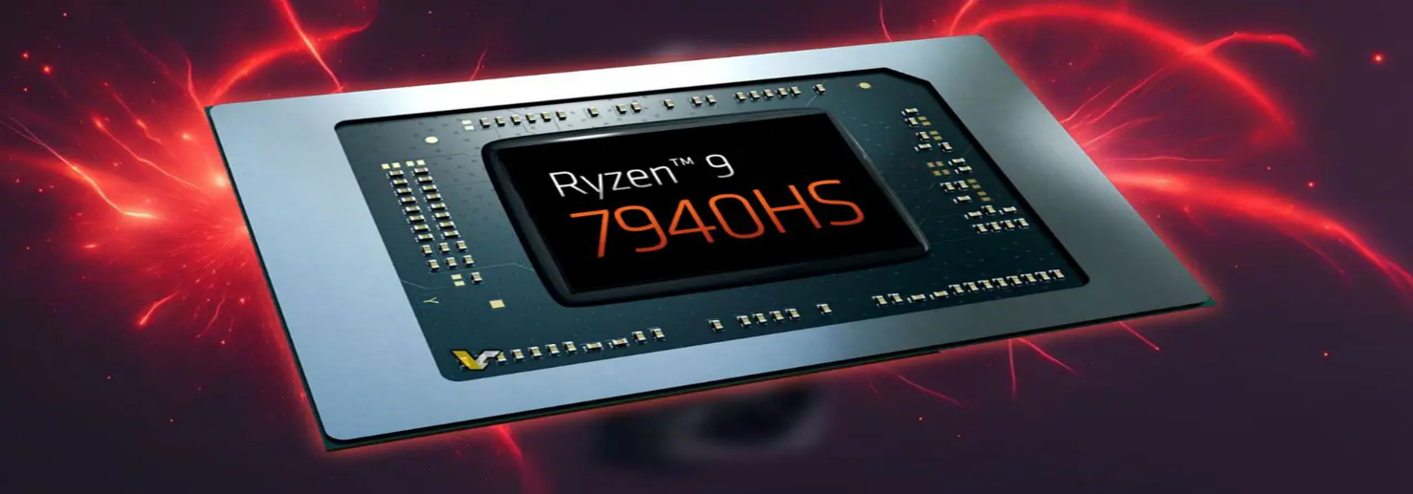
ROG Zephyrus G14
Processor
The Zephyrus G14 2023 is powered by the latest AMD Ryzen™ 9 7940HS processor and up to NVIDIA® GeForce RTX® 4070 Laptop GPU with up to 125W TGP, as well as MUX Switch and NVIDIA® Advanced Optimus support, this 14-inch machine is ready for whatever gaming or multitasking you can throw at it. do

Slide 8
02
Comparation

Slide 9
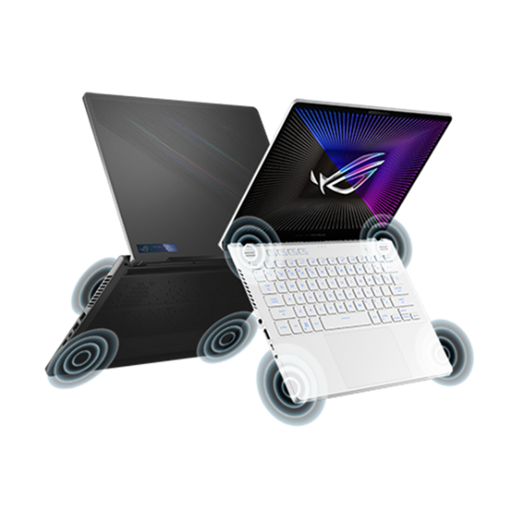

2
COMPARATION
Lenovo Legion Y740
ROG Zephyrus G14

Slide 10
2
COMPARATION
Lenovo Legion Y740
ROG Zephyrus G14
Processor
Processor
Intel Core i7-9750H (2.60 GHz base frequency, up to 4.50 GHz with Intel Turbo Boost)
AMD Ryzen 9 4900HS (3.30 GHz base frequency, up to 4.30 GHz with AMD Turbo Boost)
RAM
RAM
16GB DDR4
32GB DDR4
Storage
Storage
512GB PCIe NVMe M.2 Solid State Drive
1TB PCIe NVMe M.2 Solid State Drive

Slide 11
2
COMPARATION
Display
Display
15.6-inch Full HD (1920 x 1080) IPS, 144Hz refresh rate
14-inch WQHD (2560 x 1440) IPS, 120Hz refresh rate
Graphics
Graphics
NVIDIA GeForce RTX 2060 6GB GDDR6
NVIDIA GeForce RTX 2060 Max-Q 6GB GDDR6
Operating System
Operating System
Windows 10 Home (64-bit)
Windows 10 Home (64-bit)
Weight
Weight
4.84 lbs (2.19 kg)
3.53 lbs (1.60 kg)
Battery Life
Battery Life
Up to 6 hours
Up to 10 hours
Ports
Ports
1 x USB-C, 3 x USB 3.1, 1 x USB 3.1 (Always On), HDMI 2.0, Mini DisplayPort 1.4, Ethernet, headphone/mic combo jack
2 x USB-C (one with DisplayPort and Power Delivery), 2 x USB 3.2 Gen1 Type-A, HDMI 2.0b, headphone/mic combo jack

Slide 12

THANK YOU
When a cigarette falls in love with a match,it is destined to be hurt

